Slide 1


SAS Project : World Happiness
Katayoon Sadeghi mehr
May 29th, 2020

Slide 2
Outline
Introduction
Database Definition
Objectives
Explanatory Variables
Methodologies
Data Framework
Missing Values
Descriptive Analysis
Predictive Analysis
Business Questions
Findings
Conclusions
Recommendations
Appendix

Slide 3

Introduction
The World Happiness study is a landmark survey of the state of global happiness that ranks 156 countries by how happy their citizens perceive themselves to be.
There are 779 observation for the countries during the years 2015 to 2019. (some information are missing.)
Dependent variable is happiness_score which is a continuous variable and varies from 1 to 10.
There are 10 numeric explanatory (independent) variables and Year variable to be used to determine how happy the citizens of each country are. Just countries’ name and region are character. The rest of the variables are numeric.
Dataset Definition

Slide 4


Objectives
We would like to know:
The factors that result in a country happiness?
The change in happiness score from 2015 to 2019?
Is the world getting happier?

Slide 5
Explanatory variables are
1. “Economy (GDP per capita)” which is Purchasing Power Parity (PPP) adjusted to constant 2011 international dollars, taken from the World Development Indicators (WDI)
2. “Social support” is the national average of the binary responses (0=no, 1=yes) to the Gallup World Poll (GWP) question, “If you were in trouble, do you have relatives or friends you can count on to help you whenever you need them, or not?”
3. “Health” The time series of healthy life expectancy at birth are constructed based on data from the World Health Organization (WHO) Global Health Observatory data repository.
4. “Life Expectancy” is the expected valye of years of life at birth.
5. “Freedom” to make life choices is the national average of binary responses (0=no, 1=yes) to the GWP question, “Are you satisfied with your freedom to choose what you do with your life?”
6. “Trust” is based on a binary responses (0=no, 1=yes), “Do you trust your government?”
7. “Generosity” is the residual of regressing the national average of GWP responses (0=no, 1=yes) to the question, “Have you donated money to a charity in the past month?” on GDP per capita.
8. “Population”, 9. “Area” and 10. “Density” of countries

Slide 6
Methodologies
Using visualization such as histogram, Boxplot, Pie chart, … to obtain some information about the data such as distribution of variables, existing of outliers.
Dealing with Missing values. Replacing the missing values/Removing the missing values.
Using Univariate analysis to obtain some information about each variable such as Mean, Max, Min, Median, Q1, Q3, IQR, Missing values
Using Bivariate analysis to understand the relation/association between variables.
Using linear regression to predict the continuous Dependent variable (Happiness score).

Slide 7
Data Framework
Independent Variables
Country
Economy (GDP per capita)
Social support
Year
2015
2016
2017
2018
2019
Health
Life Expectancy
Dependent Variable
Freedom
Happiness Score
Region
Trust
Generosity
Population
Area
Density

Slide 8
Missing Values Density, Trust and Life Expectancy
“Trust “variable is missed for 2018 and 2019. So it is replaced by the average of 2017 which is 0.14.
A few “Life Expectancy” is missed and replaced with the average of the same year.
A few countries have missing Density. It is calculated by Population/Area.
Variable | N | N Miss
Life_Expectancy | 749 | 30
LE_N | 779 | 0
Trust | 468 | 311
TRUST_N | 779 | 0
Density | 703 | 76
Density_N | 779 | 0

Slide 9
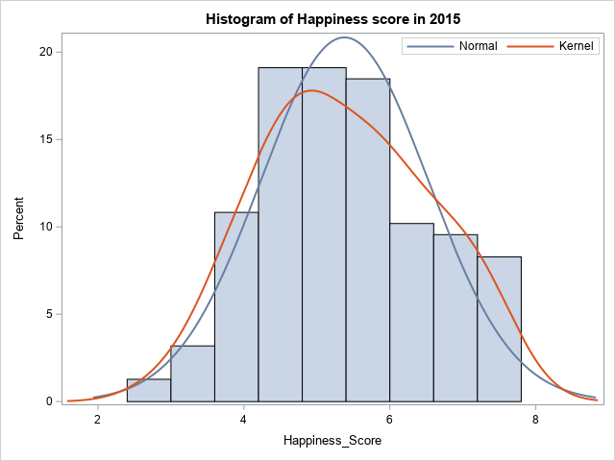
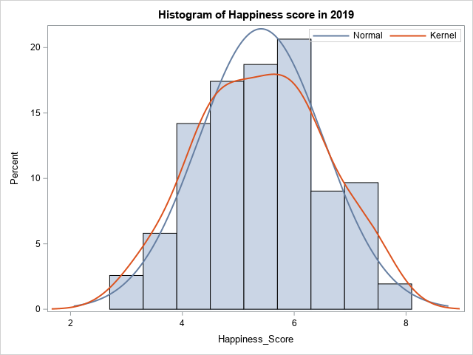
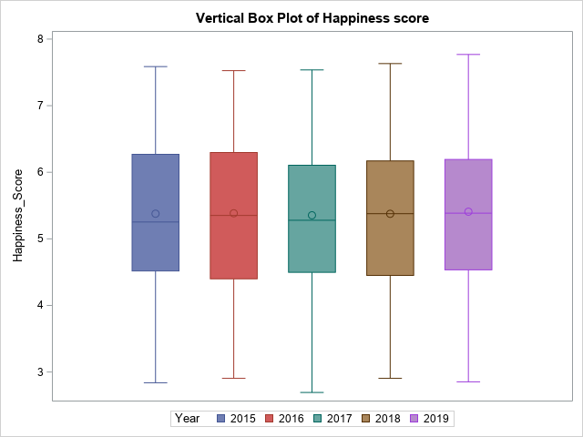
Descriptive Analysis Distribution of Happiness_Score
The distribution of happiness score is close to normal, with less happy countries with a score about 2.5 and the happiest countries around 8.
comparing the histogram of 2015 with 2019, it seems that the countries on average get a bit happier. The maximum was 7.59 in 2015 and 7.77 in 2019 with Median and Mean a bit more as well in 2019.
Analysis Variable : Happiness_Score 2015
Min | Max | Mean | Median | Mode
2.84 | 7.59 | 5.38 | 5.25 | 5.19
Analysis Variable : Happiness_Score 2019
Min | Max | Mean | Median | Mode
2.85 | 7.77 | 5.41 | 5.39 | 5.21

Slide 10
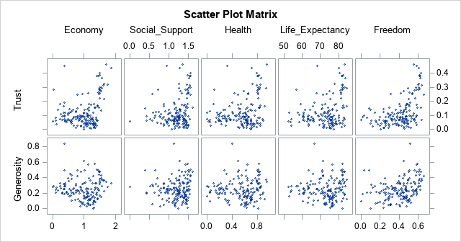
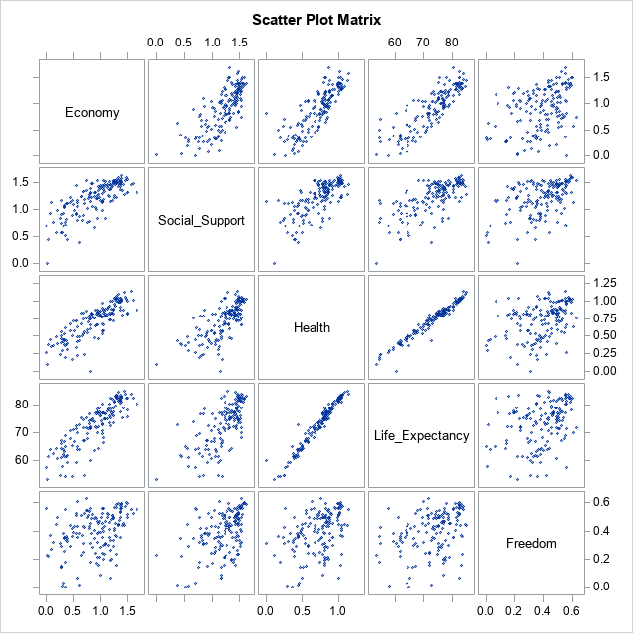
Descriptive Analysis
Correlation matrix shows:
High positive linear correlation between Health and Life Expectancy.
Positive linear correlation between Economy and Social_support and Health.
Some positive linear correlation between Trust and Freedom
Country | Avg_Trust | Avg_Life
Rwanda | 0.50 | 68.29
Qatar | 0.48 | 79.99
Singapore | 0.48 | 83.26
Denmark | 0.44 | 80.68
Sweden | 0.41 | 82.52
New Zealand | 0.41 | 82.00
Finland | 0.40 | 81.56
Switzerland | 0.40 | 83.47
United Arab | 0.36 | 77.64
Luxembourg | 0.35 | 81.95
Norway | 0.35 | 82.15
Hong Kong | 0.33 | 84.47
Australia | 0.33 | 83.12
Oman | 0.33 | 76.89
Georgia | 0.32 | 73.39
Canada | 0.31 | 82.22
Rwanda, Qatar and Singapore has the highest trust in government.
The life Expectancy for the countries where the rate of trust to the government is the highest is relatively high too.

Slide 11
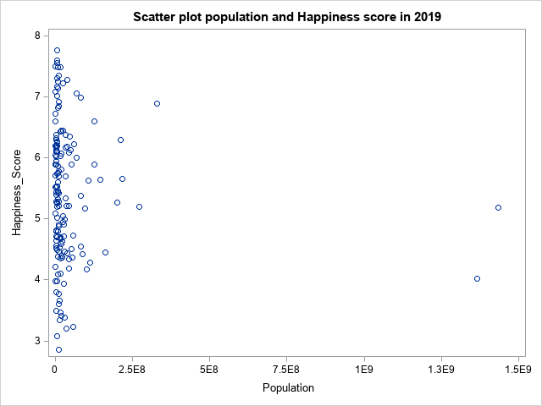
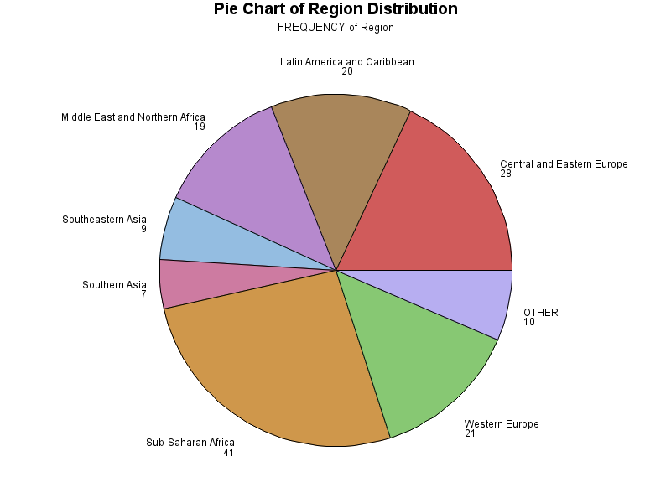
Descriptive Analysis Happiness & Population
The scatter plot shows that happiness is not associated with the county’s population as the countries with small population can be eater less happy or the happiest.
The two countries in the world with the highest population (China and India) are not very happy.
China
India
Pearson Correlation Coefficients 2019
Prob > |r| under H0: Rho=0
Number of Observations
 | Area | Population
Density | -0.08578 | 0.00400
 | 0.3153 | 0.9627
 | 139 | 138
In 2019 there is small positive correlation between the Area and Density and clearly Population and Density are highly correlated.

Slide 12
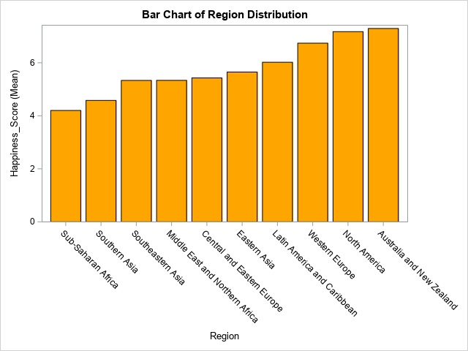
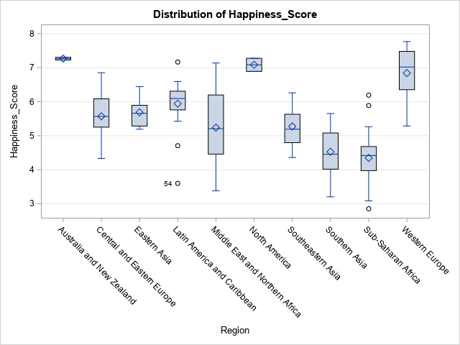
Descriptive Analysis Happiness & Region
Australia and New Zealand are the happiest in the world.
North America is next happiest part of the world.
Sub-Saharan Africa and Southern Asia are the least happy.
ANOVA test shows there is difference between the average of happiness score in 2019 in different Regions of the world.
Middle East has the most variation with the least and most happy people.
Region | Mean_H
Australia and New Zealand | 7.29
North America | 7.17
Western Europe | 6.74
Latin America and Caribbean | 6.02
Eastern Asia | 5.65
Central and Eastern Europe | 5.43
Middle East and Northern Africa | 5.34
Southeastern Asia | 5.34
Southern Asia | 4.58
Sub-Saharan Africa | 4.20
Hapinness_score based on Region in 2019
The ANOVA Procedure
Dependent Variable: Happiness_Score
Source | DF | SS | MS | MS | F Value | Pr > F
Model | 9 | 115.05 | 12.78 | 12.78 | 24.08 | <.0001
Error | 145 | 76.98 | 0.53 | 0.53
Corrected Total | 154 | 192.03

Slide 13
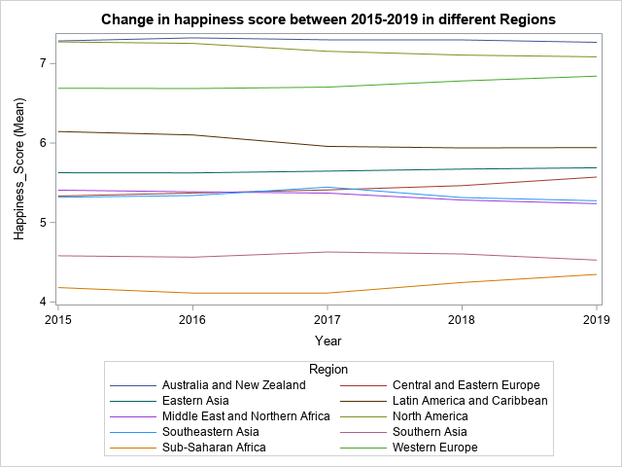
Descriptive Analysis Happiness change during time
There is not much difference during the years 2015 to 2019 in the happiness score based on the Region.
ANOVA test shows that Years in not a significant factor. There is no evidence of change in happiness score during 2015 to 2019 in any of the Regions.
Region | 2015 | 2016 | 2017 | 2018 | 2019
Australia and New Zealand | 7.29 | 7.32 | 7.3 | 7.3 | 7.27
Central and Eastern Europe | 5.33 | 5.37 | 5.41 | 5.46 | 5.57
Eastern Asia | 5.63 | 5.62 | 5.65 | 5.67 | 5.69
Latin America and Caribbean | 6.14 | 6.1 | 5.96 | 5.94 | 5.94
Middle East and Northern Africa | 5.41 | 5.39 | 5.37 | 5.28 | 5.24
North America | 7.27 | 7.25 | 7.15 | 7.11 | 7.09
Southeastern Asia | 5.32 | 5.34 | 5.44 | 5.31 | 5.27
Southern Asia | 4.58 | 4.56 | 4.63 | 4.6 | 4.53
Sub-Saharan Africa | 4.18 | 4.11 | 4.11 | 4.24 | 4.35
Western Europe | 6.69 | 6.69 | 6.7 | 6.78 | 6.84
Source | DF | Anova SS | MS | F Value | Pr > F
Year | 4 | 0.231981 | 0.057995 | 0.11 | 0.9789
Region | 9 | 605.2829 | 67.25366 | 128.07 | <.0001
Year*Region | 36 | 4.229103 | 0.117475 | 0.22 | 1

Slide 14
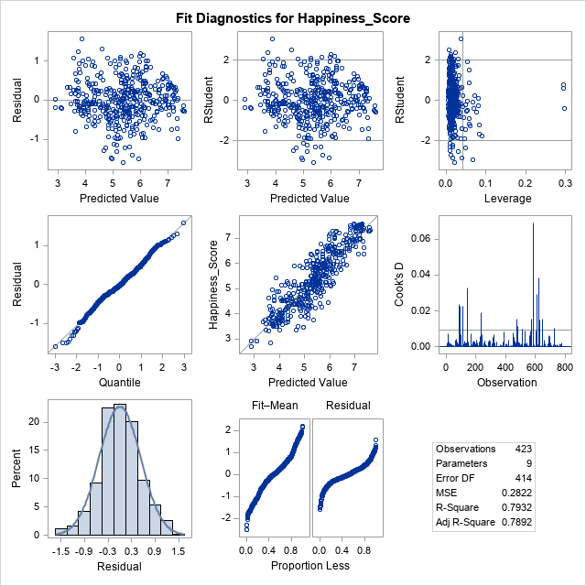
Predictive Analysis Linear Regression on Happiness_score
X variables are Area, Density, Economy, Social_Support, Health, Freedom, Trust and Generosity. (Population is highly correlated with Density, Life Expectancy is highly correlated with Health so they are not in the model.
R-Square and adjusted R-Square of the model are 0.7932 and 0.7892 respectively.
All the x variables are significant. But the coefficients for Area and Density are almost zero.
Y = 2.21+1.07 Economy+0.46 Social_support+1.46 Health+1.35 Freedom+1.13Trust+0.67Generosity
Source | DF | SS | MS | F Value | Pr > F
Model | 8 | 448.15729 | 56.01966 | 198.51 | <.0001
Error | 414 | 116.83177 | 0.2822
Corrected Total | 422 | 564.98906
Parameter Estimates
Variable | DF | Parameter | Standard | t Value | Pr > |t|
 |  | Estimate | Error
Intercept | 1 | 2.2161 | 0.09916 | 22.35 | <.0001
Area | 1 | 0.0000 | 1.53E-08 | 3.03 | 0.0026
Density | 1 | -0.0001 | 3.78E-05 | -2.53 | 0.0119
Economy | 1 | 1.0721 | 0.1148 | 9.34 | <.0001
Social_Support | 1 | 0.4617 | 0.1095 | 4.22 | <.0001
Health | 1 | 1.4583 | 0.17942 | 8.13 | <.0001
Freedom | 1 | 1.3544 | 0.22775 | 5.95 | <.0001
Trust | 1 | 1.1296 | 0.28182 | 4.01 | <.0001
Generosity | 1 | 0.6664 | 0.22018 | 3.03 | 0.0026

Slide 15

Business Questions
What are the factors that result in a country’s happiness?
Has there any change in happiness score from 2015 to 2019?

Slide 16
Findings
Happiness score has a normal distribution of (5.4, 1.1), so the probability of average happiness is the highest.
Density and Population are highly correlated. Clearly the more populated the country, the more dense it is.
Happiness depends on the Region where the country is located. More stable part of the world such as Australia/ New Zeeland and North America are happier. Looking at the histogram and ANOVA test approve this hypothesis. This is true for all the years (2015 to 2019).

Slide 17
Findings
There is positive linear correlation between some of the explanatory variables:
Health and Life Expectancy.
The healthier the higher chance of living longer.
Economy and Social_support and Health.
The better Economy does, the better Health care system the citizens have and a better social life they have.
Trust and Freedom.
As Citizen Trust their government more, they feel more freedom.

Slide 18
Findings
Population doesn’t affect happiness. Courtiers with small population can be the least happy or the most happy. However the 2 most populated countries in the world are not that much happy.
Middle East has a wide range of happiness score some countries such as Israel, UAE, Qatar are very happy while some other countries such as Yemen and Syria are opposite.
There is no significant change in happiness score during 2015 to 2019. so based on a 5-year study we can not detect any positive or negative trend for happiness score.

Slide 19
Conclusions
There are many factors affecting the happiness of citizens of a country. Based on the political, natural or social changes, the happiness score may change as well.
Economy, Social_Support, Health, Freedom, Trust and Generosity are positively related with Happiness_score. The more they are, the happier is the country.
To predict Happiness score for years in future we need to have more data. This dataset only contains a period of 5 years between 2015 and 2019 and is not enough.

Slide 20



Recommendations
All this factors will eventually results in a happier country.
By improving Economy, people may be more Generous.
By selecting better Governments and having more democracy, people may have more trust and freedom.
By improving Social aspects of life, people may feel having more social support and be healthier.

Slide 21
The End
Thank you for your attention

